Slide 1
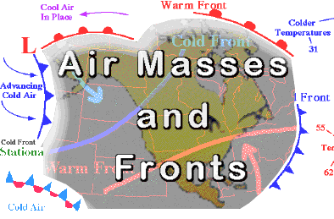
Air Masses and Fronts

Slide 2
Air Mass:
An air mass is a huge body of air that has similar temperature, humidity, and air pressure at any given height.
Air masses are classified by 2 characteristics
Temperature
Humidity
The characteristics of an air mass depend on the temperatures and moisture content of the region over which the air mass formed.
Tropical: warm, air masses formed in the tropics
Polar: cold, air masses form near north or south pole
Maritime: air masses formed on oceans or seas
Continental: air masses formed over land

Slide 3
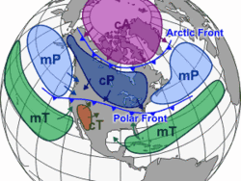
The colder the air the higher the air pressure subsequently the hotter the air the lower the air pressure.
Cold air → more dense
Hot air → less dense
There are 4 major types of air masses that affect the weather of the U.S.
Maritime tropical
Maritime polar
Continental tropical
Continental polar

Slide 4
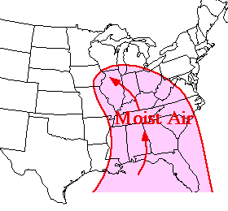
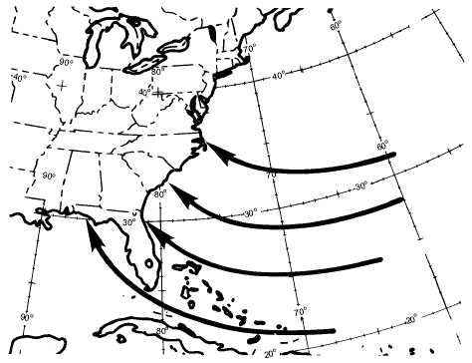
Maritime tropical
Warm, wet air masses
On the east coast they are formed over the Gulf of Mexico & south Atlantic Ocean.
Influence weather along the entire east coast.
Summer: thunderstorms & summer showers
Winter: heavy snow or rain
On the west coast they form over the southern Pacific Ocean.

Slide 5
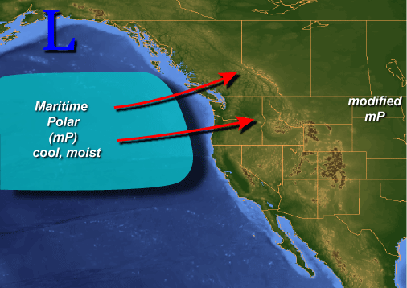
Maritime polar
Cold, wet air masses
On the east coast they are formed over the north Atlantic Ocean.
On the west coast they are formed over the north Pacific Ocean.
Influence the weather of the west coast more so than that of the east coast.
Summer/Winter: fog, rain, & cooler temperatures

Slide 6
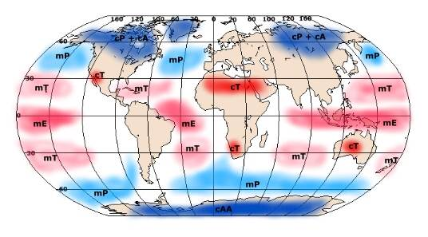
Continental tropical
Warm, dry air masses
Typically form over the southwest (New Mexico, Arizona, Nevada, as well as northern Mexico) during the summer months.
Influence the weather of the southwestern part of the US & southern Great Plains (Kansas, Oklahoma, Texas, Iowa).
Summer: Hot, dry

Slide 7
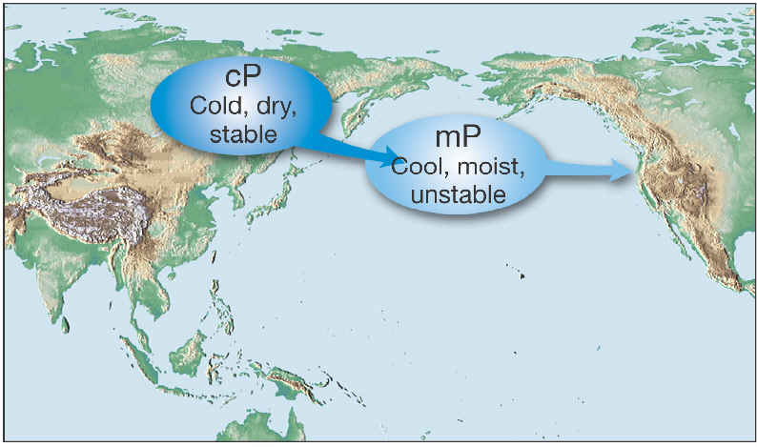
Continental polar
Cold, dry air masses
Typically form over central & northern Canada as well as Alaska.
Influence the weather of the entire United States.
Winter: Clear, cold, dry
Summer: Potential for storms due to interaction with Maritime tropical air moving up from the Gulf of Mexico.

Slide 8
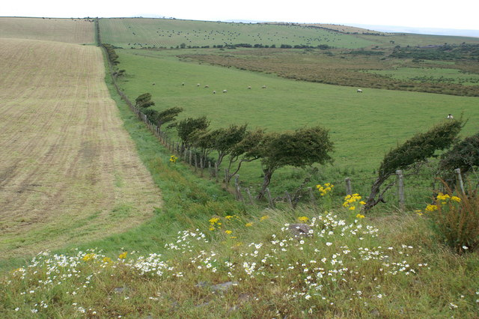
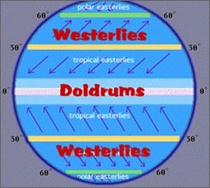
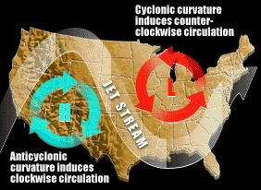
2 primary methods for air mass movement
Prevailing Westerlies
Pushes air masses from west to east.
Jet streams
Pushes fast moving air masses from west to east.

Slide 9
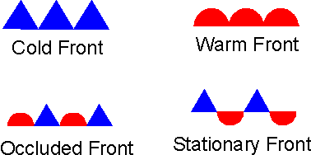
Fronts
The boundary between two air masses.
Air masses do not easily mix with each other due to the differences in…
Density (Air pressure)
Temperature
Moisture content
Storms & different types of weather phenomena occur along fronts.

Slide 10
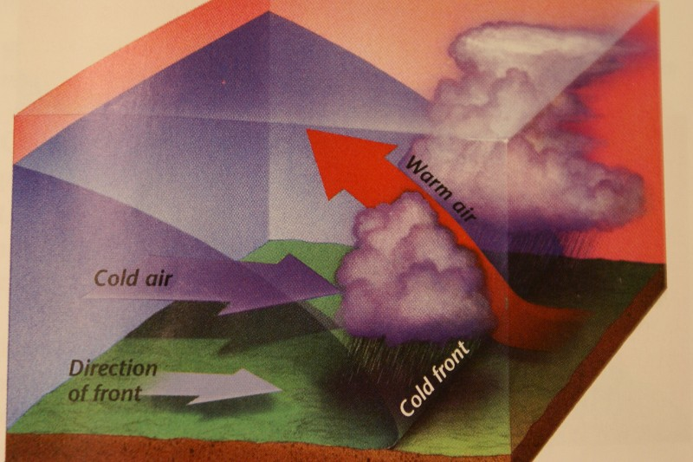
Fronts
Cold front
Fast moving cold air mass overtakes a slower moving warm air mass.
Can cause abrupt weather changes particularly thunderstorms.
Clear skies, a change in wind, & lower temperatures usually follow a cold front.
http://www.youtube.com/watch?v=XcHHiULyrPY

Slide 11
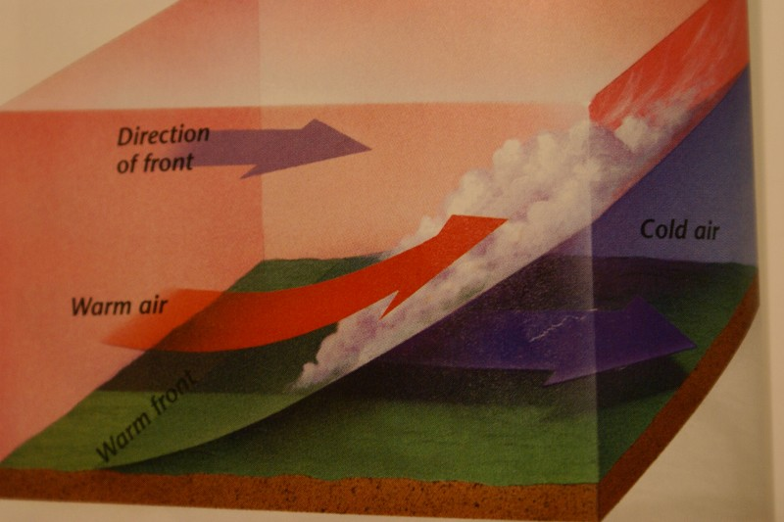
Warm front
A fast moving warm air mass overtakes a slow moving cold air mass.
Can cause extended periods of rainy or cloudy weather.
Warm, humid weather usually follows a warm front.
http://www.youtube.com/watch?v=huKYKykjcm0&feature=related

Slide 12
3. Stationary front
A cold and warm air mass meet but neither can move the other.
Can cause extended periods of precipitation; snow, rain, fog or clouds.
4. Occluded front
A warm air mass is caught between 2 cooler air masses.
http://www.phschool.com/atschool/phsciexp/active_art/weather_fronts/

Slide 13
Cyclones (Greek for “wheel”)
Formed around centers of low pressure.
Caused as the boundary between fronts become distorted by surface features; mountains or strong winds.
Represented on weather maps by an L.
Warm air rises and spins counterclockwise around the center.
Storms and precipitation are associated with areas of low pressure.

Slide 14
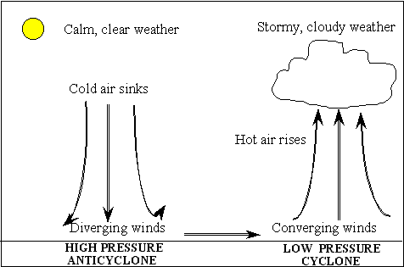
Anticyclones
Formed around centers of high pressure.
Represented on weather maps by an H.
Cold air sinks and spins clockwise around the center.
Dry weather and clear skies are associated with areas of high pressure.

