Slide 1
Life Processes Notes

Slide 2
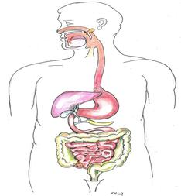
Digestion
The process of breaking down of food into a smaller useable form.
Example - Chewing
& the digestive
system

Slide 3
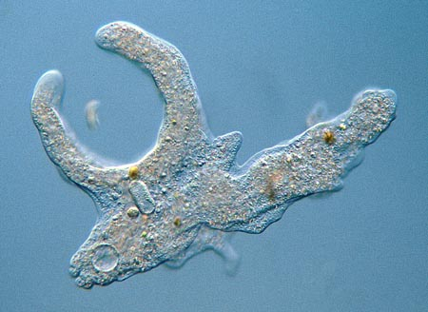
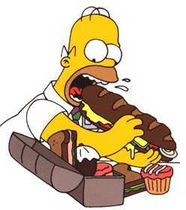
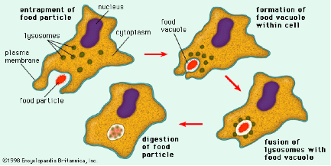
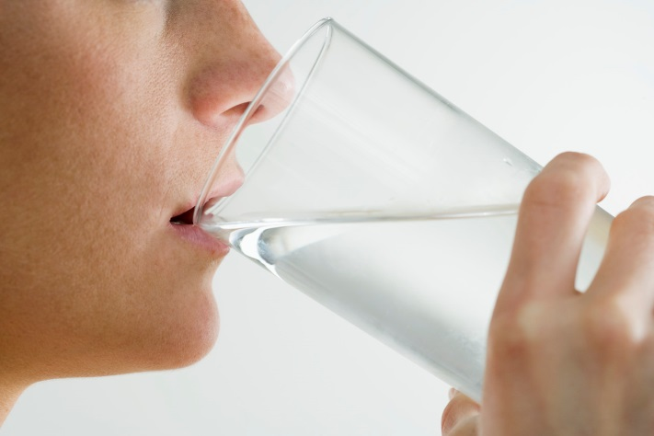
Ingestion
The process of taking food or drink in
Example - taking a bite of something, amoeba surround its prey, drinking

Slide 4
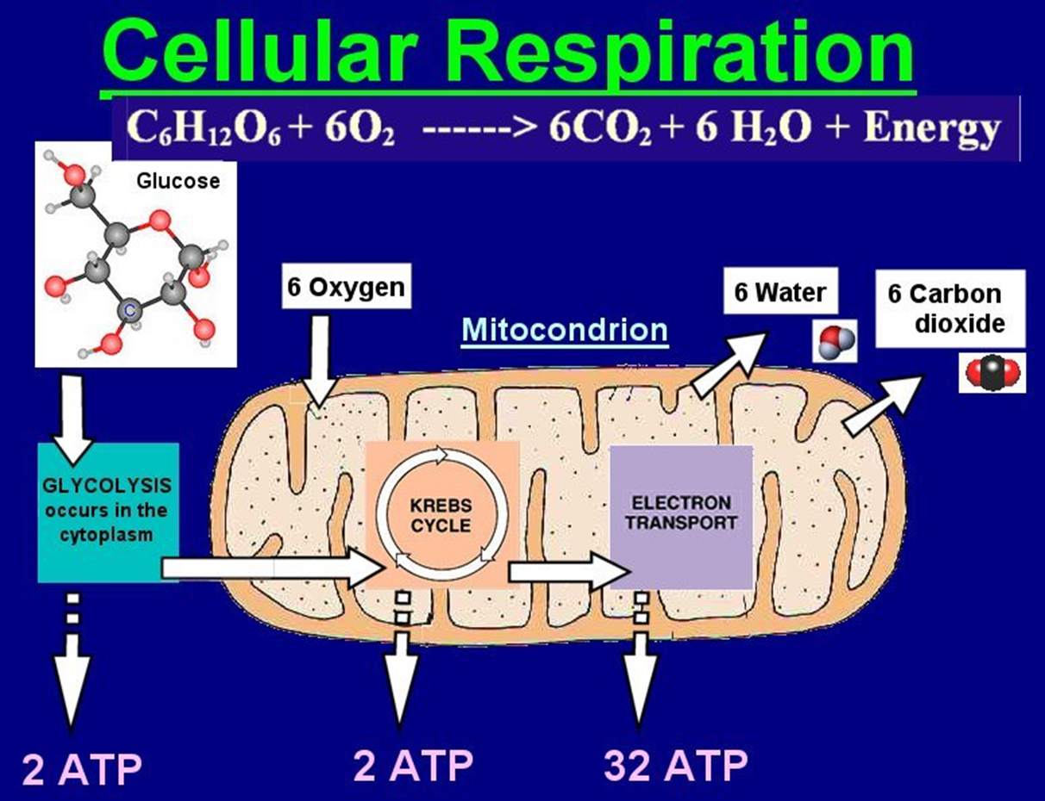
Cellular Respiration
Process of breaking down food (glucose) using the chemical oxygen to release energy (mechanical).
Breathing is inhalation/
exhalation that
involves
respiration
Example: occurs
in the mitochondria
of cells, breathing

Slide 5
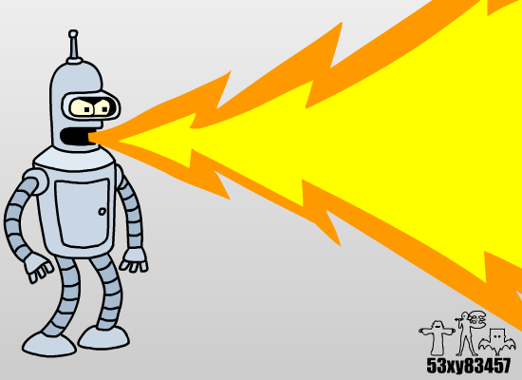
Regulation
An attempt to make cell
organism “normal” by responding to
stimuli within environment, organism,
cell or surroundings.
Examples – moving your
hand away from something
hot, yawning, crying,
screaming when startled,
vomiting, burping, sleeping,
etc.

Slide 6
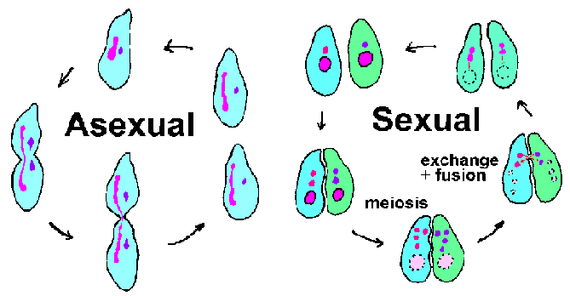
Reproduction
Process to make more of a cell or organism. Can be asexual (budding, mitosis, meiosis, fission, regeneration) or sexual (male & female sex cells must fuse)
Example –
cut healing,
babies, buds
on trees,
growing.

Slide 7
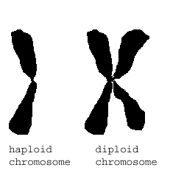
Reproduction
How are new cells created asexually?
Body (somatic) cells – created by mitosis & have the full number of chromosomes in each (diploid): lungs, skin, liver, brain, hair, muscle, bone, etc.
Sex (gamete) cells – created by meiosis & have ½ the number of
chromosomes in each
(haploid): egg & sperm cells
**NUCLEUS decides when it is
time to reproduce.

Slide 8
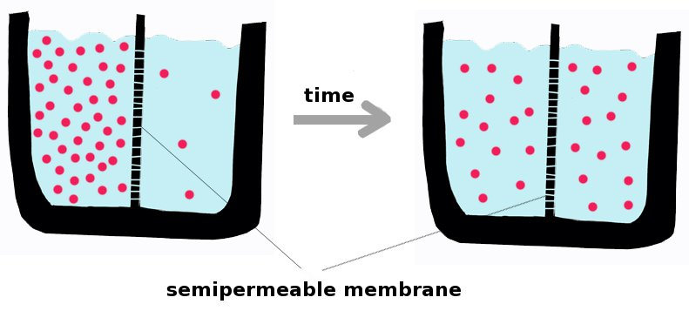
Transport
Process of moving materials in, out & around cell or organism
Example- osmosis, difussion, circulatory system, exocytosis, endocytosis, etc.

Slide 9
Excretion
Process of removing waste from the cell or organism.
Example – urination, pooping,
exocytosis,
vomiting, lymph
system, kidneys,
passing gas,
lysosomes, etc.

Slide 10
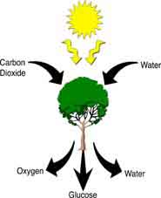
Photosynthesis
Not a life process of all living things, but it is for plants & producers.
Using the sun’s energy
carbon dioxide
& water are
converted into
glucose (food) &
oxygen for the
plant to survive.

